Slide 1

Project Phase-I Presentation & Demonstration on “FoodFinder: A Restaurant Recommender System”
Students:
Varsha Ravindra (1RN15CS119)
Sunidhi Hegde (1RN15CS110)
Guide:
Prof. Dr. H.R.Shashidhar
Asst. Prof. Dept. of CSE, RNSIT
Department of Computer Science and Engineering
RNS Institute of Technology
2018-19

Slide 2
CONTENTS
INTRODUCTION
Problem Statement
Existing System and Limitations
Proposed system
REQUIREMENTS
Functional Requirements
Non-functional Requirements
Hardware & Software Requirements
SYSTEM ARCHITECTURE
1. DFD/Sequence diagram/Flowchart
4. DETAILED DESIGN
1. Modules implemented
2. Libraries used / API’s
5. IMPLEMENTATIONS
1. Algorithm/Methods/Pseudo code
6. RESULT ANALYSIS
7. CONCLUSION
8. REFERENCES

Slide 3
INTRODUCTION
Problem Statement
Providing related content out of relevant and irrelevant collection of items to users of online service providers.
Restaurant recommender system aims to recommend restaurants to users based on user-restaurant ratings, reviews, price and location

Slide 4
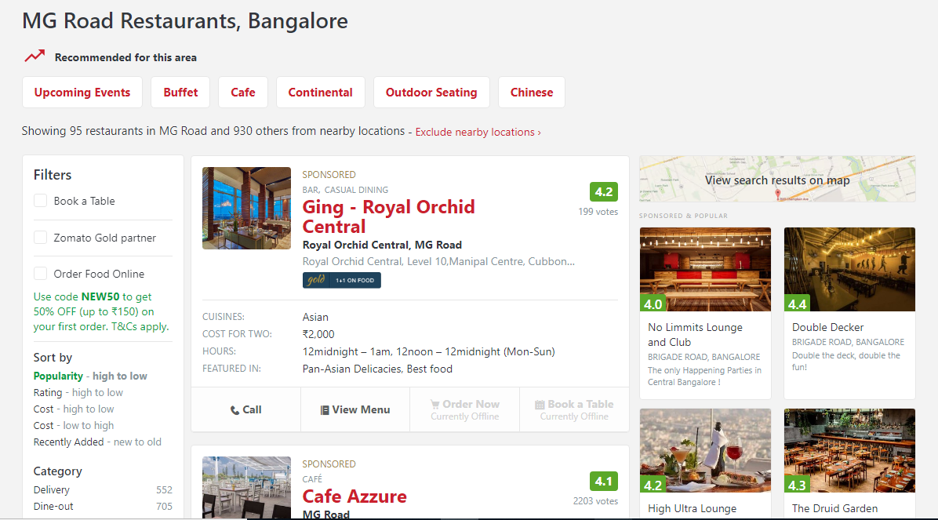
Existing system and it’s limitations
Does not take user interest into account
Neglects the influence of different rating standards
Less accountable result

Slide 5
Proposed system
A restaurant recommender system which uses collaborative filtering to provide recommendations based on ratings provided by other similar users and the browsing history of the current user.
Advantages
Higher algorithm performance
More accurate results

Slide 6
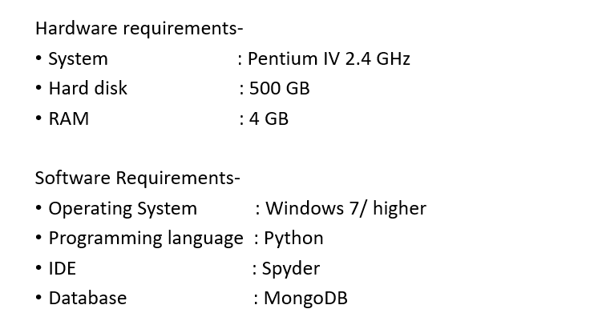
REQUIREMENTS
Hardware and Software Requirements:

Slide 7
Functional Requirements:
Take user input and provide recommendations accordingly.
If the user has previously ordered using the application, recommendations are provided based on the order history.
Non-Functional Requirements:
Improved accuracy.
Improved performance.

Slide 8
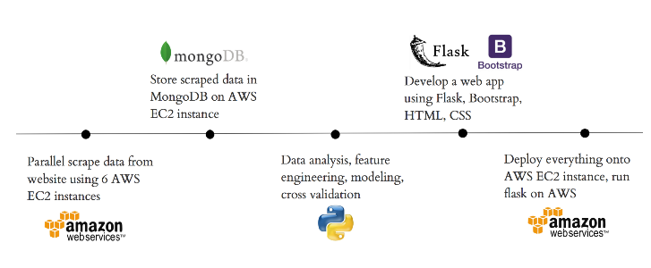
SYSTEM ARCHITECTURE

Slide 9
DETAILED DESIGN
Modules implemented:
Exploratory Data Analysis (EDA)
Data Cleaning
Train / Test Split (75:25)
Sparse Matrix Creation
Finding Global Average
Cold Start Problem
Algorithm Implementation
Comparison of efficiency between models

Slide 10
Libraries Used:
Numpy - It is a library for Python, adding support for large, multi-dimensional arrays and matrices, along with a large collection of high-level mathematical functions to operate on these arrays.
Pandas - It is a software library written for the Python programming language for data manipulation and analysis.
Matplotlib and seaborn – They are a plotting library for Python.
Sklearn - Scikit-learn is a free software machine learning library for Python.
Scipy - It contains modules for optimization, linear algebra, integration, special functions, signal and image processing etc.,
Surprise – It is a simple Python library for building and testing recommender systems.

Slide 11
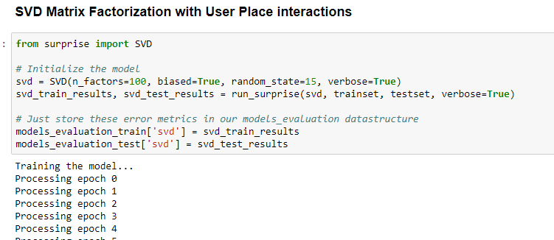
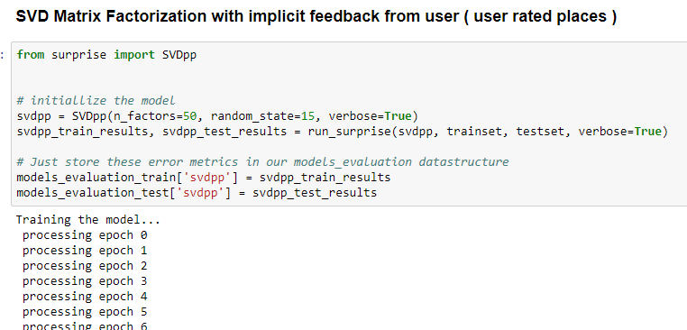
IMPLEMENTATION
Implementing SVD and SVD++ algorithms

Slide 12
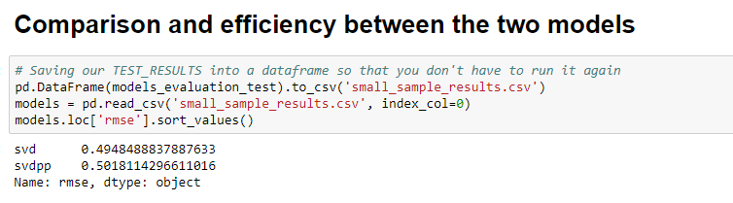
RESULT ANALYSIS

Slide 13
CONCLUSION
Existing system limitations
Does not take user interest into account
Neglects the influence of different rating standards
Less accountable result
Proposed system
A restaurant recommender system which uses collaborative filtering to provide recommendations based on ratings provided by other similar users and the browsing history of the current user.
Advantages
Higher algorithm performance
More accurate results

Slide 14
REFERENCES
Hybrid recommender systems: Survey and experiments, User-modelling and User-adapted interactions , November 2002
https://www.sciencedirect.com/science/article/pii/S1110866515000341
https://www.datacamp.com/community/tutorials/recommender-systems-python
https://en.wikipedia.org/wiki/Recommender_system
https://www.marutitech.com/recommendation-engine-benefits/
https://towardsdatascience.com/my-journey-to-building-book-recommendation-system-5ec959c41847

Slide 15

PROJECT SETUP AND DEMONSTRATION

Slide 16
Suggestions….!

Slide 17
THANK YOU!!!

